Slide 1

CS-M151B
Computer Systems Architecture
Blaise Tine
UCLA Computer Science

Slide 2

Attendance

Slide 3
Agenda
Super Scalar Processors

Slide 4
CPU Performance
Latency
Time it takes to complete a task
Throughput
Number of tasks completed per given time

Slide 5
CPU Performance
Example of throughput
Computation capacity: FLOPS (floating-point operations per sec)
Memory bandwidth: GB/s (memory bytes transfer per sec)

Slide 6
CPU Performance
How do we improve CPU performance?
CPU Time = IC * CPI * CT
IC: instruction count
CPI: cycles per instructions
CT: clock cycle time

Slide 7
CPU Performance
Review: How do we improve CPU performance?
CPU Time = IC * CPI * CT
IC: instruction count
CPI: cycles per instructions
CT: clock cycle time

Slide 8
CPU Performance
Multi-cycle architecture affect?
smaller CT
Why?
Any downside?
CPI increases
CPU Time = IC * CPI * CT
IC: instruction count
CPI: cycles per instructions
CT: clock cycle time

Slide 9
CPU Performance
Pipeline architecture improve?
Smaller CT
Smaller CPI
CPU Time = IC * CPI * CT
IC: instruction count
CPI: cycles per instructions
CT: clock cycle time

Slide 10
CPU Performance
More pipeline stages improve?
Smaller CT
Same CPI
CPU Time = IC * CPI * CT
IC: instruction count
CPI: cycles per instructions
CT: clock cycle time

Slide 11
CPU Performance
Downside of more pipeline stages?
CT reduction is limited
CPI will increase: more pipeline hazards
Hardware cost: more forwarding paths
CPU Time = IC * CPI * CT
IC: instruction count
CPI: cycles per instructions
CT: clock cycle time

Slide 12
CPU Performance
How do we reduce CPI?
Increase the instruction throughput

Slide 13
CPU Performance
IPC: Instructions per cycle
Instruction throughput
IPC = 1 / CPI
How many instructions to executed per cycle
Higher is better
CPU Time = (IC * CT) / IPC
IC: instruction count
IPC: instructions per cycle
CT: clock cycle time

Slide 14
CPU Performance
CPU Paralleling Types
ILP: instruction-level parallelism
TLP: thread-level parallelism
MLP: memory-level parallelism

Slide 15
SuperScalar Processor
Exercice: How do we extend scalar pipeline for IPC=2?
IF Stage:
PC
No replication
Instruction Memory
Multiple read ports
Nader ECE-M116C

Slide 16
SuperScalar Processor
Exercice: How do we extend scalar pipeline for IPC=2?
ID Stage:
Decode
Replication
Register file
Multiple read ports
Nader ECE-M116C

Slide 17
SuperScalar Processor
Exercice: How do we extend scalar pipeline for IPC=2?
EX Stage:
ALU
Replication
Partitioning
Nader ECE-M116C

Slide 18
SuperScalar Processor
Exercice: How do we extend scalar pipeline for IPC=2?
MEM Stage:
Data Memory
No replication
Nader ECE-M116C

Slide 19
SuperScalar Processor
Exercice: How do we extend scalar pipeline for IPC=2?
WB Stage:
Register File
Multiple write ports
Nader ECE-M116C

Slide 20
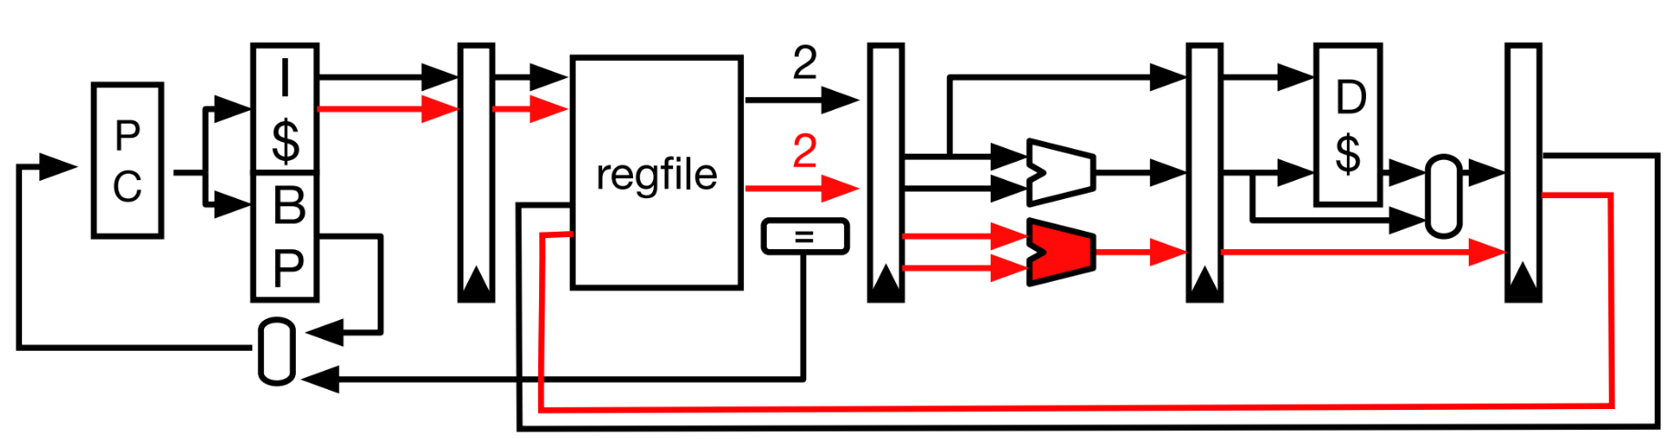
SuperScalar Processor
Exercice: How do we extend scalar pipeline for IPC=2?
Nader ECE-M116C

Slide 21
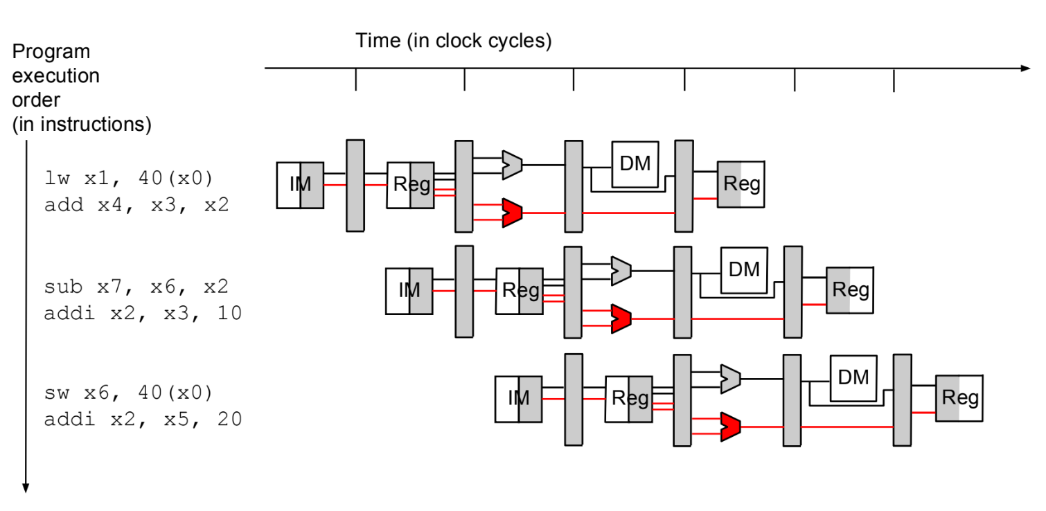
SuperScalar Processor
Exercice: How do we extend scalar pipeline for IPC=2?
Nader ECE-M116C

Slide 22
SuperScalar Processor
Hardware complexity
Data forwarding cost
Replicate the path

Slide 23
SuperScalar Processor
Data dependency issue? (N=2)
ADD r1 <- r1, r3
ADD r6 <- r4, r3
No

Slide 24
SuperScalar Processor
Data dependency issue? (N=2)
ADD r3 <- r1, r2
ADD r3 <- r4, r1
Yes: WAW: write ordering should be enforced
Delay the bottom write

Slide 25
SuperScalar Processor
Data dependency issue? (N=2)
ADD r3 <- r1, r2
ADD r6 <- r4, r3
Yes: RAW: r3 read before being written
Need expensive checks

Slide 26
SuperScalar Processor
How many RAW checks? (N=4)
ADD rd1 <- rs1a, rs1b
ADD rd2 <- rs2a, rs2b
ADD rd3 <- rs3a, rs3b
ADD rd4 <- rs4a, rs4b
12 checks: 6 + 4 + 2

Slide 27
SuperScalar Processor
Tradeoffs
Pros:
Higher IPC
Cons:
Hardware cost
Replication
Dependency checks
Pipeline stalls limit IPC

Slide 28
SuperScalar Processor
SuperScalar best-case performance
When instructions have no dependencies
Doesn’t happen often enough
Need to allow other non-dependent instructions to execute

Slide 29
SuperScalar Processor
Scalar: can process at most one instruction per cycle
SuperScalar: can process at most N instructions per cycle

Slide 30
Out of Order Execution
If the next instruction cannot move forwards due to dependencies, we skip it and pick the next one.
The instruction window size determines pipeline utilization
Notes:
Instr window = range of instructions to search

Slide 31
Out of Order Execution
OoO Design Challenges?
Finding an available instruction
How do we track dependencies when ordering is broken?
How do we handle pipeline hazards?
How do we preserve ordering for external states?
Register and memory
Notes:
Instr window = range of instructions to search

Slide 32
Static Scheduling
Compiler re-order the instruction
Internally track dependencies
Check register use
How do we do that in the compiler?
add r1,r2,r3
sub r4,r1,r3
and r6,r2,r7
add r1,r2,r3
and r6,r2,r7
sub r4,r1,r3
All sources are ready?
Why not execute them?
Notes:
Instr window = range of instructions to search

Slide 33
Dynamic Scheduling
How to reduce register dependencies?
Notes:
Instr window = range of instructions to search

Slide 34
Dynamic Scheduling
Can we increase the number of registers to work with?
You cannot change the ISA (our S/W contract)
Notes:
Instr window = range of instructions to search

Slide 35
Dynamic Scheduling
Solution:
Use internal registers: “physical” registers
We will call ISA registers “logical” or “architected”
initially map logical registers to physical registers
Notes:
Instr window = range of instructions to search

Slide 36
HW Register Renaming
Needed Features:
mapping mechanism
physical registers
allocation/deallocation mechanism
allocated vs. free registers
Notes:
Instr window = range of instructions to search

Slide 37
HW Register Renaming
Program code
Exercise:
Identify all data dependencies
I1: ADD R1, R2, R3
I2: SUB R2, R1, R5
I3: AND R5, R11, R7
I4: OR R8, R5, R2
I5: XOR R2, R4, R11
RAW
WAR
WAW
Notes:
Instr window = range of instructions to search

Slide 38
HW Register Renaming
Program code
Exercise
3 RAWs
1 WAR
1 WAW
Which instructions cannot be reordered?
I1: ADD R1, R2, R3
I2: SUB R2, R1, R5
I3: AND R5, R11, R7
I4: OR R8, R5, R2
I5: XOR R2, R4, R11
RAW
WAR
WAW
Notes:
Instr window = range of instructions to search

Slide 39
HW Register Renaming
Program code
Exercise
I3 can not exec before I2 because I3 will overwrite R5
I5 can not go before I2 because I2, when it goes, will overwrite R2 with a stale value
I1: ADD R1, R2, R3
I2: SUB R2, R1, R5
I3: AND R5, R11, R7
I4: OR R8, R5, R2
I5: XOR R2, R4, R11
RAW
WAR
WAW
Notes:
Instr window = range of instructions to search

Slide 40
HW Register Renaming
Program code
Exercise
I3 can not exec before I2 because I3 will overwrite R5
I5 can not go before I2 because I2, when it goes, will overwrite R2 with a stale value
I1: ADD R1, R2, R3
I2: SUB R2, R1, R5
I3: AND R5, R11, R7
I4: OR R8, R5, R2
I5: XOR R2, R4, R11
RAW
WAR
WAW
Notes:
Instr window = range of instructions to search

Slide 41
HW Register Renaming
Program code
Example
Let’s rename R5 to decouple I2 and I3
R5 = S
Removed WAR
I1: ADD R1, R2, R3
I2: SUB R2, R1, R5
I3: AND R5, R11, R7
I3: AND S, R11, R7
I4: OR R8, R5, R2
I5: XOR R2, R4, R11
RAW
WAR
WAW
Notes:
Instr window = range of instructions to search

Slide 42
HW Register Renaming
Program code
Example
I4 also needs to change since R5 is S
I1: ADD R1, R2, R3
I2: SUB R2, R1, R5
I3: AND R5, R11, R7
I3: AND S, R11, R7
I4: OR R8, S, R2
I5: XOR R2, R4, R11
RAW
WAR
WAW
Notes:
Instr window = range of instructions to search

Slide 43
HW Register Renaming
Program code
Example
Let’s rename R2 to decouple I2 and I5
R2 = T
Removed WAW
I1: ADD R1, R2, R3
I2: SUB R2, R1, R5
I3: AND R5, R11, R7
I3: AND S, R11, R7
I4: OR R8, S, R2
I5: XOR T, R4, R11
RAW
WAR
WAW
Notes:
Instr window = range of instructions to search

Slide 44
HW Register Renaming
Program code
Register renaming eliminates
WAR dependencies
WAW dependencies
I1: ADD R1, R2, R3
I2: SUB R2, R1, R5
I3: AND R5, R11, R7
I3: AND S, R11, R7
I4: OR R8, S, R2
I5: XOR T, R4, R11
RAW
WAR
WAW
Notes:
Instr window = range of instructions to search

Slide 45
HW Register Renaming
Program code
Implementation
Space for S, T, etc.
How do we know when to rename a register?
I1: ADD R1, R2, R3
I2: SUB R2, R1, R5
I3: AND R5, R11, R7
I3: AND S, R11, R7
I4: OR R8, S, R2
I5: XOR T, R4, R11
RAW
WAR
WAW
Notes:
Instr window = range of instructions to search

Slide 46
HW Register Renaming
Program code
Simple Solution
Do renaming for every instruction
Change the name of a register each time we decode an instruction that will write to it.
Remember what name we gave it ☺
I1: ADD R1, R2, R3
I2: SUB R2, R1, R5
I3: AND R5, R11, R7
I3: AND S, R11, R7
I4: OR R8, S, R2
I5: XOR T, R4, R11
RAW
WAR
WAW
Notes:
Instr window = range of instructions to search

Slide 47
Register File Organization
We need some physical structure to store the register values
Architected
Register
File
ARF
“Outside” world sees the ARF
RAT
PRF
One PREG per instruction in-flight
Register
Alias
Table
Physical
Register
File
Notes:
Instr window = range of instructions to search

Slide 48
Putting it all together
top:
R1 = R2 + R3
R2 = R4 – R1
R1 = R3 * R6
R2 = R1 + R2
R3 = R1 >> 1
BNEZ R3, top
Free pool:
X9, X11, X7, X2, X13, X4, X8, X12, X3, X5…
R1
X1
R2
X2
R3
X3
R4
X4
R5
X5
R6
X6
X7
RAT
X8
X9
List all instructions for 2 loop iterations
Show graph when only RAW enforced
Show graph when all deps enforced
Rename the registers
R1
R1
X10
R2
R2
X11
R3
R3
X12
R4
R4
X13
R5
R5
X14
R6
R6
X15
X16
Notes:
Instr window = range of instructions to search

Slide 49
Putting it all together
R1 = R2 + R3
R2 = R4 – R1
R1 = R3 * R6
R2 = R1 + R2
R3 = R1 >> 1
BNEZ R3, top
R1 = R2 + R3
R2 = R4 – R1
R1 = R3 * R6
R2 = R1 + R2
R3 = R1 >> 1
BNEZ R3, top
List all instructions for 2 loop iterations
Notes:
Instr window = range of instructions to search

Slide 50
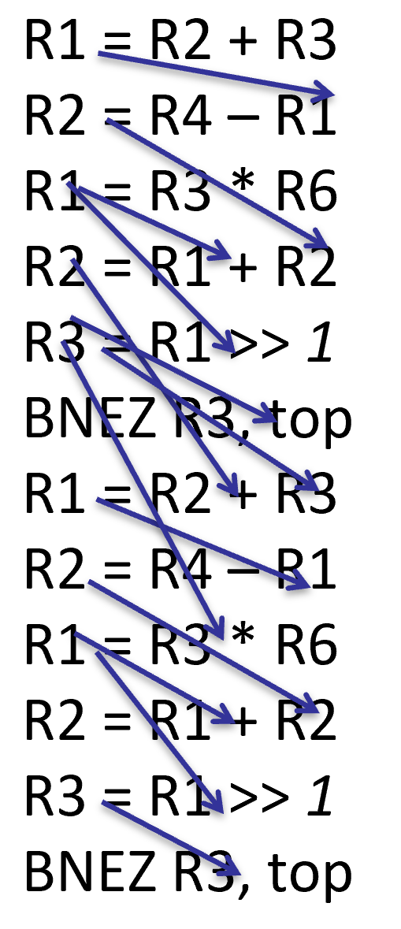
Putting it all together
2. Show graph when only RAW enforced
RAW
WAR
WAW
Notes:
Instr window = range of instructions to search

Slide 51
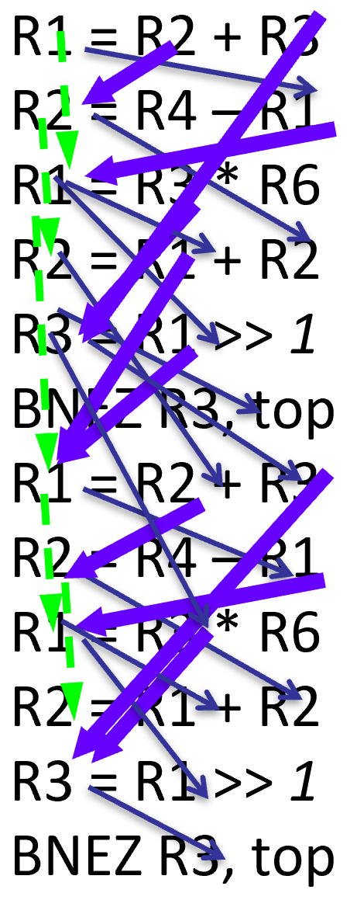
Putting it all together
3. Show graph when all deps enforced
RAW
WAR
WAW
Notes:
Instr window = range of instructions to search

Slide 52
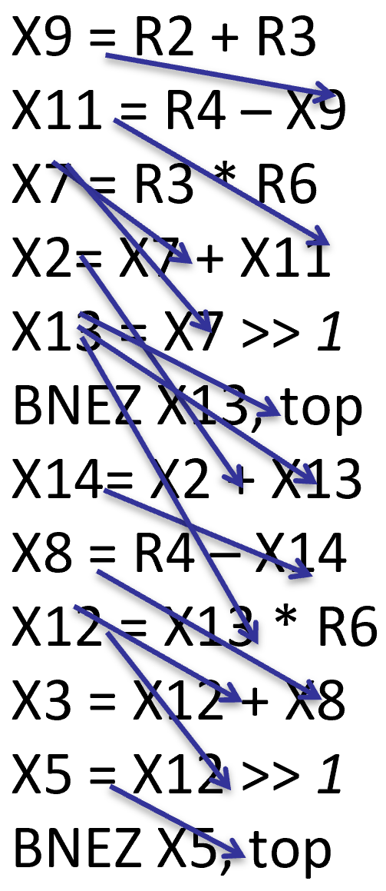
Putting it all together
4. Rename the registers
R1
X1
Free pool:
X9, X11, X7, X2, X13, X4, X8, X12, X3, X5…
R2
X2
R3
X3
R4
X4
R5
X5
R6
X6
X7
X8
X9
R1
R1
X10
X9
X7
X14
X12
R2
R2
X11
X11
X2
RAW
WAR
WAW
X8
X3
R3
X13
X12
R3
X5
R4
R4
X13
R5
R5
X14
R6
R6
X15
X16
Notes:
Instr window = range of instructions to search

Slide 53
HW Register Renaming
We keep using new physical registers
What happens when we run out?
We stall the pipeline until they are freed
Notes:
Instr window = range of instructions to search

Slide 54
HW Register Renaming
When do we recycle physical registers?
When not needed any more, i.e we have given its value to all instructions that use it as a source operand!
Need to tracking mechanism
Notes:
Instr window = range of instructions to search

Slide 55
HW Register Renaming
Architected register file contains
the “official” processor state
ARF
R3
When an instruction leaves the
pipeline, it makes its result
“official” by updating the ARF
RAT
R3
PRF
The ARF now contains the
correct value; update the RAT
Free Pool
T42
T42 is no longer needed, return
to the physical register free pool
Notes:
Instr window = range of instructions to search

Slide 56
HW Register Renaming
R3 could be using a different PRF at commit
ARF
R3
Update ARF as usual
Deallocate physical register
RAT
Don’t touch the RAT!
(Someone else is the most
recent writer to R3)
R3
PRF
T17
At some point in the future,
the newer writer of R3 exits
Free Pool
T42
This instruction was the most
recent writer, now update the RAT
Deallocate physical register
Notes:
Instr window = range of instructions to search

Slide 57
Q&A

Slide 58
Acknowledgement
This course is partly inspired and use materials from the following courses created by my colleagues:
ECE-M1126C: Nader Sehatbakhsh @ UCLA
CS3220: Hyesoon Kim @ gatech

